Slide 1
COVID-19 IN PATIENTS WITH CKD
Recommendations for the prevention, mitigation and containment of the emerging SARS-CoV-2 (COVID-19) pandemic in haemodialysis centres:
Document recomandat de Societatea Română de Nefrologie
25 Martie 2020
Notes:
Impactul asupra centrelor de Hemodializa si a pacientilor hemodalizati nu este foarte bine cunoscut.

Slide 2
Summary:
What is the particularity of the HD patients in COVID 19 disease?
What is the epidemic impact of infection in a HD center: report from one HD center in Wuhan, China
Management of patients on dialysis during COVID 19 infection
Management of patients on transplant during COVID 19 infection

Slide 3
What is the particularity of the HD patients in COVID 19 disease?
1. They have older age and have certain comorbid conditions (as cardiovascular disease, hypertension, diabetes, and lung diseas);
2. They compose a large scale cluster;
3. They are scattered in different centers across the city;
4. They are highly mobile. Patients should regularly return to their residences and hospitals;
5. They usually receive concentrated dialysis treatment in a large space;
6. Their immune functions are impaired;
7. When they are infected, they become a potential source of mobile infection.
HD patients and HD centers need to be given priority in epidemic prevention and control
Notes:
Deci…care este particularitatea pacientilor dializati si de ce ar trebui sa ii avem in vedere in detrimental altor pacienti cu boli cornice? – in general sunt pacienti varstnici, care au comorbiditati- cv, diabet, afectiuni pulmonare;
- Pacientii dializati formeaza un cluster heterogen pe scara larga;
Sunt distribuiti in diferite centre cu locatii diferite intr-un oras
Sunt pacienti care se deplaseaza intrucat dupa cum bine stiu de 3 ori pe saptamana fac un circuit care implica un centru/ spital si locul de resedinta
De obicei sedinta de dializa se tine intr-un spatiu mare
Sistemul lor imunitar este afectat
Cand contacteaza infectia, ei reprezinta o sursa potential de infectie mobila.

Slide 4
it is not yet possible to accurately describe the incidence of COVID-19 in MHD patients.
it is also not possible to provide detailed information regarding the clinical course of the disease in MHD patients
there are no reports of any widespread transmission among MHD patients
understanding about the epidemiology of the disease is the standardization of its diagnostic criteria
Notes:
Ce stim despre pacientii hemodializati si COVID 19?
Majoritatea informatiilor despre cum COVID 19 afecteaza pacientii dializati sunt inca in forma de studii preliminare si nu au trecut inca de “peer-review”, ceea ce este de asteptat dat fiind ca boala nu s-a atins inca peak-ul in majoritatea partilor din lume, datele inca fiind procesate.
Astfel nu avem date in ceea ce priveste incidenta bolii la pacintii hemodializati, cursul clinic al bolii la pacientii dializati si nu sunt date in ceea ce priveste raspandirea bolii la aceasta categorie
De asemenea nu exista o standardizare a criteriilor de diagnostic-> la momentul actual dg punandu-se pe prezenta simptomelor respiratorii superioare/ inferioare, modificarile radiologice, confirmarea ARN viral prin PCR. Insa studiile recente au aratat ca la un numar considerabil de pacienti cu suspiciune clincia inalta la care exudatul faringian a fost negativ, ex sputei a iesit pozitiv.

Slide 5
2. What is the epidemic impact of infection in a HD center: report from one HD center in Wuhan, China
Report that reviewed the whole course of the epidemic emerged in the HD center of Renmin Hospital, Wuhan University from January 14, 2020, the day the first case was confirmed, to February 17, 2020.
37 cases among 230 HD patients（16.09%) and 4 cases among 33 (12.12%）staff being diagnosed with COVID-19.
The epidemiology, clinical presentation and immune profile of dialysis patients contracted COVID-19 were further studied.
Notes:
Impactul epidemiei covid 19 in randul pac dializati precum si a centrelor de hemodializa a fost descries intr un raport care a recapitulate intregul curs a epidemiei izbucnite intr-un centru de dializa la sp renmin. 37 de cazuri intre 230 de pac (16, 09%) si 4 cazuri dintre 33 personal au fost diagnosticati cu COVID 19;
Astfel au fost studiate epidemiologia, prezentarea clinica si profilul imun al pac dializati care au contactat covid 19

Slide 6
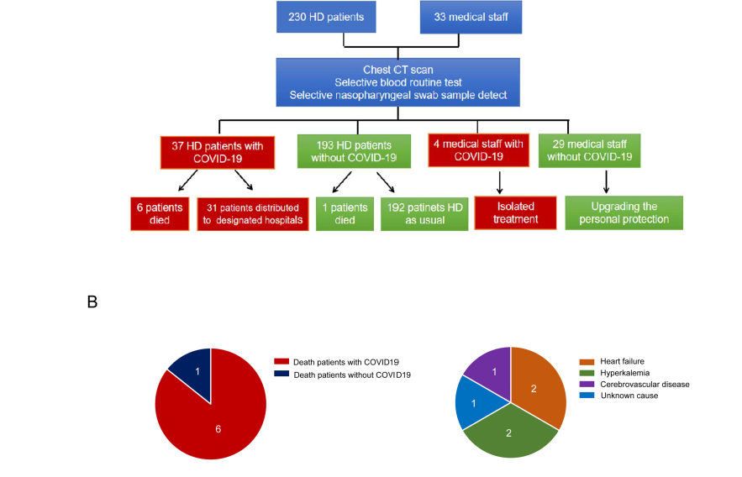
2. What is the epidemic impact of infection in a HD center: report from one HD center in Wuhan, China
Notes:
CA si rezultate, din cei 230 de pacienti si 33 de membri ai personalului centrului inclusi in acest studiu, 37 (16,09) de cazuri au fost diagnosticate cu covid 19, dintre care 6 pac au decedat. Restul de 31 de pacienti au fost distribuiti sa efectueze sedintele de hd in spital. Au exista 7 decese, pe parcurusl follow upului dintre care 6 survenite la pac cu covid 19 si 1 la un pac fara covid. Toate mortile au fost de cauze cardiovasculare (insuf cardiaca), hiperkaliemie si boala cerebrovasculara, si nici unul dintre ele determinate de complicatii ale COVID 12.

Slide 7
2. What is the epidemic impact of infection in a HD center: report from one HD center in Wuhan, China
HD Patients with COVID-19 are mostly clinical mild and unlikely progress to severe pneumonia
Notes:
Contrar rezultatelor extrase din studiile SARS si MERS, simptomele clinice ale pacientilor dializati nu au fost atat de evidente aratand ca doar 4 (11%) dintre pacienti au avut febra, 3 (8%) au prezentat oboseala si 1 singur caz simptome de tuse, durere toracica, respectiv dispnee. De asemenea, explorarile computer tomografice au aratat ca 41 % au prezentat afectare unilaterala si 59% afectare bilaterala, 62% avand aspectul de geam mat characteristic pneumoniei cu COVID 19.

Slide 8
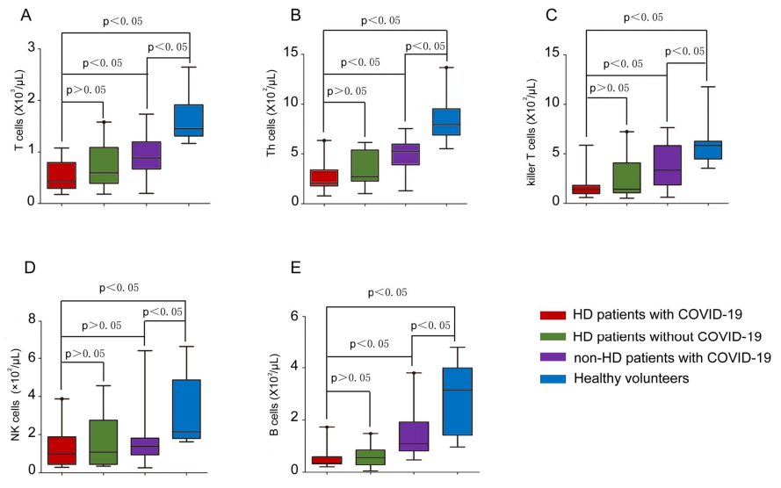
2. What is the epidemic impact of infection in a HD center: report from one HD center in Wuhan, China
Notes:
In lumina rezultatelor prezentate mai sus, speculatiile autorilor au fost ca acest lucru s-a intamplat din cauza sistemului imun deosebit al acestor pacienti.
Asa ca s-au testat markerii imunitatii celulare si umorale si dupa cum putem vedea si in aceste grafice
-nivelurile cellule t, th, killet t si NK serice la pacientili hemodializati au fost foarte scazute comparativ cu pac non dializati.

Slide 9
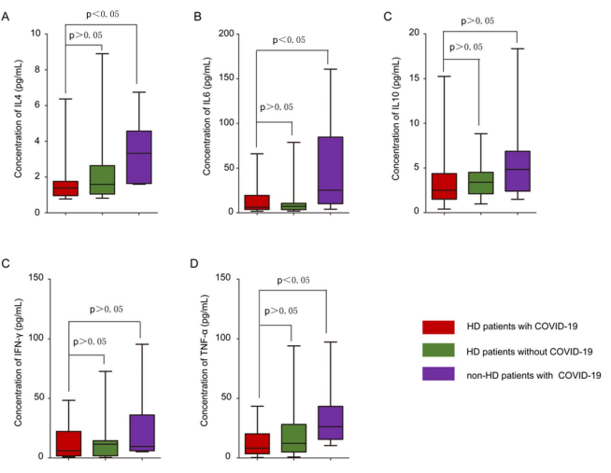
2. What is the epidemic impact of infection in a HD center: report from one HD center in Wuhan, China
Notes:
Mai mult decat atat s-a observat ca nivelurile serice de cytokine IL-4, IL-6, TNF-a, ifn gama la pac nedializati cu infectie au fost semnificativ mai crescute decat la pac dializati si infectati. Aceste rezultate sugereaza ca sistemul imun al pacientilor dializati este compromise, pe de o parte fiind incapabil sa determine un raspuns imun efficient, insa pe de alte parte s-a dovedit a fi protectiv (intrucat acesti pacienti au facut forme usoare de boala, raspunsul imun ineficient neputand starni furtuna citokinina responsabila de evolutia spre ARDS si spre disfunctie de organ). In lumina descoperirilor facute de autorii acestui studiu, acestia sugereaza ca corticoterapia sa fie administrate cu maxima prudenta la acesti pacienti intrucat sistemul lor imunitar este deja supresat.

Slide 10
2. What is the epidemic impact of infection in a HD center: report from one HD center in Wuhan, China
2 key measures in response to epidemic:
upgrading level of prevention
starting universal screening, isolation and distributing the infected cases.
EPIDEMIC CONTROL
Notes:
Masurile cheie luate pentru limitarea raspandirii:
marirea nivelului de protective si inceperea screeningului universal, isolarea si redistribuirea cazurilor infectare

Slide 11
3. Management of patients on dialysis during COVID 19 infection
Notes:
In primul rand cum putem reduce transmisia in centrele de HD? Acest review from ERA EDTA ne furnizeaza recomandari in ceea ce priveste preventia si atenuarea, precum si izolarea epidemiei COVID- 19 in centrele de hemodializa. Managementul pacientilor dializati afectati de catre COVID 19 trebuie facut utilizand protocoale stricte de minimalizare a riscului pentru ceilalti pacienti dar si pentru personalul centrului. In ceea ce priveste recomandarile pentru personalul centrului, acestea implica training in ceea ce priveste epidemia de COVID 19, metodele de preventie, noile ghiduri de practica actualizate, precum si training in ceea ce priveste utilizarea echipamentului de protectie. Automonitorizarea simptomelor, autoizolarea in caz de simptomatologie sugestiva.
In ceea ce priveste recomandarile pentru pacientii dializati acestea includ distantarea sociala, instructajul pacientilor in ceea ce priveste igiena mainilor, igiena respiratorie, monitorizarea temperaturii corporale la inceputul si sfarsitul sedintei, recunoasterea si izolarea pacientilor care prezita simptomatologie respiratorie. Ideal acestia vor face sedintele intr-o incapere separata izolata de ceilalti pacienti, intr o tura separata la sfarsitul programului pana la excluderea infectiei. Vor trebui sa poarte masca tot timpul.
Pacientii cu infectii confirmate trezuie izolati intr o camera de izolare si li se va asigura sedinta de hemodializa intr-o unitate spitaliceasca. Personalul medical care se ocupa de acesti pacienti trebuie sa fie echipati cu echipament de protectie complet.
Autorii atrag atentia asupra preventiei care joaca un rol important in controlul epidemiei si minimizarea impactului asupra populatiei de pacienti de hemodializati.

Slide 12
3. Management of patients on dialysis during COVID 19 infection
Early recognition and isolation of individuals with respiratory infection/ upper respiratory infection symptoms or fever:
(i) identifying the patients with sign and symptoms BEFORE enter the waiting room or tratment area;
(ii) patients MUST inform the staff about the symptoms of respiratory tract BEFORE the arrival in dialysis facility;
(iii) separating the patients to an appropiate treatment area as soon as possible;
(iv) all patients with upper tract respiratory symptoms should be dialysed in a separating isolation room, in which a negative pressure atmosphere can be established, with door closed;
(v) waiting in a separate isolation room;
(vi) to receive dialysis in the last shift of the day until infection is excluded;
(vii) patients should wear a proper (surgical or N95) mask filtering 95% of the particulate matter of exhaled air;
* all patients who have fever, cough, upper airway involvment or conjunctivitis should be screened for novel COVID 19 infection.

Slide 13
3. Management of patients on dialysis during COVID 19 infection
CDC recommends that patients with respiratory symptoms should be directed to report to hospitals rather that being dialysed in isolation in dialysis facilities UNLESS the facility can fully comply with CDC's guidance.
(i) when the inpatient hemodialysis units reach capacity, patients with symptoms will have to be dialysed at outpatient hemodialysis facilities;
(ii) they should wear a facemask as soon as they arrive at the facility and during their stay.
Notes:
De asemenea, Centrul de Preventie si Control al Bolilor a realizat un ghid oficial care poate fi accesat liber pe site-urile CDC si ASN.

Slide 14
3. Management of patients on dialysis during COVID 19 infection
Notes:
De asemenea, editorialul din AJKD a detaliat masurile prezente pana la acest moment in literatura in ceea ce priveste coordonarea centrelor de hemodializa in acest context epidemiologic si le-au au impartit in 4 mari grupuri.

Slide 15
3. Management of patients on dialysis during COVID 19 infection
https://www.cdc.gov/coronavirus/2019-ncov/healthcare-facilities/dialysis.html
Notes:
De asemenea, Centrul de Preventie si Control al Bolilor a realizat un ghid official care poate fi accesat liber pe site-urile CDC si ASN.

Slide 16
3. Management of patients on dialysis during COVID 19 infection
The experience in Brescia support the observations of Chinese that the disease has a less severe course in dialysis patients, compare not only with the transplant patients, but also to non-nephropathic patients
observational informations => lack of data;
Brescia is the second largest area affected in Bergamo and a nephrology working group adapted the Guidelines on the Therapeutic and Support Management of patients with COVID-19 Coronavirus Infection. Edition 2.0 12 March 2020 for the dialysis and kidney-transplanted patients
Notes:
Lipsa datelor adecvate, atat in populatia generala, dar cu atat mai mult la pacientii nefrologici si cei transplantati, ne lasa inca in zona dezbaterilor in ceea ce priveste managementul bolii la acesti pacienti, precum si abordarea terapeutica. Brescia este a doua cea mai afectata zona in Bergamo, iar experienta acestora sustine rezultatele publicate de chinezi in ceea ce priveste cursul mai putin sever a pacientilor dializati, comparative nu numai cu pacientii transplantati dar si fata de populatia generala. Grupul de lucru din Brescia a adaptat Ghidul de management al pacientilor cu COVID 19 la pacientii dializati si transplantati

Slide 17
3. Management of patients on dialysis during COVID 19 infection
Proper logistic planning: reconcile infection protocols (e.g. isolation) with needs that are intrinsic to our specialty (e.g. the need to move patients for haemodialysis)
Notes:
Este necesar un plan logistic in mangementul acestei urgente si anume regandirea protocoalelor de infectie (izolarea pacientilor) cu nevoie care tin strict de specialitatea nefrologica (necesitatea de hemodializa). De asemenea ei ne prezinta un model organizational al institutiei lor, implementat cu success.

Slide 18
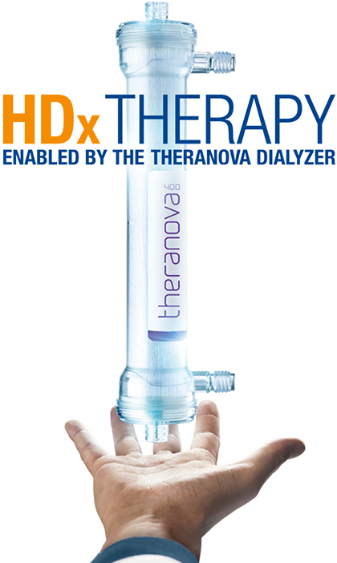
3. Management of patients on dialysis during COVID 19 infection
Notes:
Pacientii HD asimptomatici sau cu forme usoare de boala: posibil izolare la domiciliu daca acest lucru este compatibil cu asigurarea transportului; acesti pacienti trebuie sa poarte masca in permanenta

Slide 19
3. Management of patients on dialysis during COVID 19 infection

Slide 20
3. Management of patients on dialysis during COVID 19 infection

Slide 21
4. Management of patients on transplant during COVID 19 infection
Logistics considerations: better outcome in transplanted patients directly managed in a nephrology ward compared to the group managed in other general COVID areas;
Notes:
Experienta celor din Brescia, desi limitata, sugereaza un outcome mai bun al pacientilor transplantati infectati cu COVID-19 care au fost tratati in sectia de nefrologie, comparativ cu grupul celor care au fost tratati in sectiile speciale COVID si au primit doar consultatie, intrucat observatiile preliminare arata ca boala are o evolutie mai severa la aceasta categorie de pacienti, cu situatii amenintatoare de viata.

Slide 22
4. Management of patients on transplant during COVID 19 infection
Notes:
In cazurile asimptomatice sau cele usoare de boale, bazat pe ratiunea clinica, se poate decide spitalizarea sau managementul la domiciliu. Daca pacientii sunt izolati la domiciliu este necesara monitorizarea temperaturii si a saturatiei periferice a oxigenului daca este posibil si comunicarea zilnica cu centrul de transplant.
NOTE: Daca evolutia este favorabila, desi nu sunt date suficiente despre timingul si metodele de reintroducere a terapiei imunosupresoare, abordarea autorilor a fost sa se reintroduce inhibitorul de calcineurina la jumatate din doza anterioara, dupa 15 zile de la disparitia simpt si negativarea exudatului pana la atingerea gradual a….
In functie de caz, se poate lua in discutie si reinitierea MMF, aza sau inhib de m tor

Slide 23
4. Management of patients on transplant during COVID 19 infection
Notes:
In cazurile asimptomatice sau cele usoare de boale, bazat pe ratiunea clinica, se poate decide spitalizarea sau managementul la domiciliu. Daca pacientii sunt izolati la domiciliu este necesara monitorizarea temperaturii si a saturatiei periferice a oxigenului daca este posibil si comunicarea zilnica cu centrul de transplant.
NOTE: Daca evolutia este favorabila, desi nu sunt date suficiente despre timingul si metodele de reintroducere a terapiei imunosupresoare, abordarea autorilor a fost sa se reintroduce inhibitorul de calcineurina la jumatate din doza anterioara, dupa 15 zile de la disparitia simpt si negativarea exudatului pana la atingerea gradual a….
In functie de caz, se poate lua in discutie si reinitierea MMF, aza sau inhib de m tor

Slide 24
4. Management of patients on transplant during COVID 19 infection

Slide 25
4. Management of patients on transplant during COVID 19 infection
Notes:
Daca evolutia este favorabila, desi nu sunt date suficiente despre timingul si metodele de reintroducere a terapiei imunosupresoare, abordarea autorilor a fost sa se reintroduca inhibitorul de calcineurina la jumatate din doza anterioara, dupa 30 zile de la disparitia simpt si dupa 2 rez al exudatului negative (1- 15 zile si 1- 30 de zile) pana la atingerea gradual a….
In functie de caz, se poate lua in discutie si reinitierea MMF, aza sau inhib de m tor
Remdesivirul ar trb teoretic sa fie considerat prima linie la pac cu deteriorare clinica rapida sau la cei cu f severe de pneumonie, ARDS sau insuf respiratorie, decompensare hemodinamica, necesar de ventilatie mecanica.

Slide 26
4. Conclusions
HD and kidney transplant patients have the immune function impaired;
When they are infected, they become a potential source of mobile infection.
SARS CoV-2 virus seems to be less detrimental to HD patients
HD Patients with COVID-19 are mostly clinical mild and unlikely progress to severe pneumonia due to the impaired cellular immune function and incapability of mounting cytokines storm.
More attention should be paid to prevent cardiovascular events, which may be the collateral impacts of COVID-19 epidemic on HD patients or for this patients not to skip their dialysis
Proper logistic planning
Antiviral therapy (according to the protocol or your country); no need for adjusting
For patients undergoing dialysis the use of Theranova filter for the clearance of inflammation mediators.
better outcome in transplanted patients directly managed in a nephrology ward compared to the group managed in other general COVID areas;
Notes:
Trebuie luat in considerare sistemul imun compromise al pacientilor dializati, dar mai ales a celor transplantati
Virusul SARS Cov-2 pare sa aiba un impact mai scazut in organismal pac dializati, insa nu si la cei transplantati
Pacientii HD prezinta forma usoare de boala, iar evolutia pare sa nu fie spre pneumonie sau ARDS iar principalul mechanism sta in sistemul imunitar compromise al pacientilor care este incapabil sa determine o furtuna citokinica
Trebuie avute in vedere evenimentele cardiovasculare care pot avea impact collateral infectiei covid 19 la pac dializati si de asemenea trebuie evitata sarirea sedintelor de hemodializa
Elaborarea unor strategii logistice bine puse la punct
Terapia antivirala conform protocolului; nu necesita ajustarea dozelor
La pacientii care fac hemodializa utilozarea filtrelor de imunoabsorbtie ar putea ajuta la eliminarea mediatorilor inflamatiei din system
Iar in ceea ce priveste pac transplantati, s-a observat un outcome mai favorabil comparative cu grupurile manageriate in sectiile COVID

